Slide 1

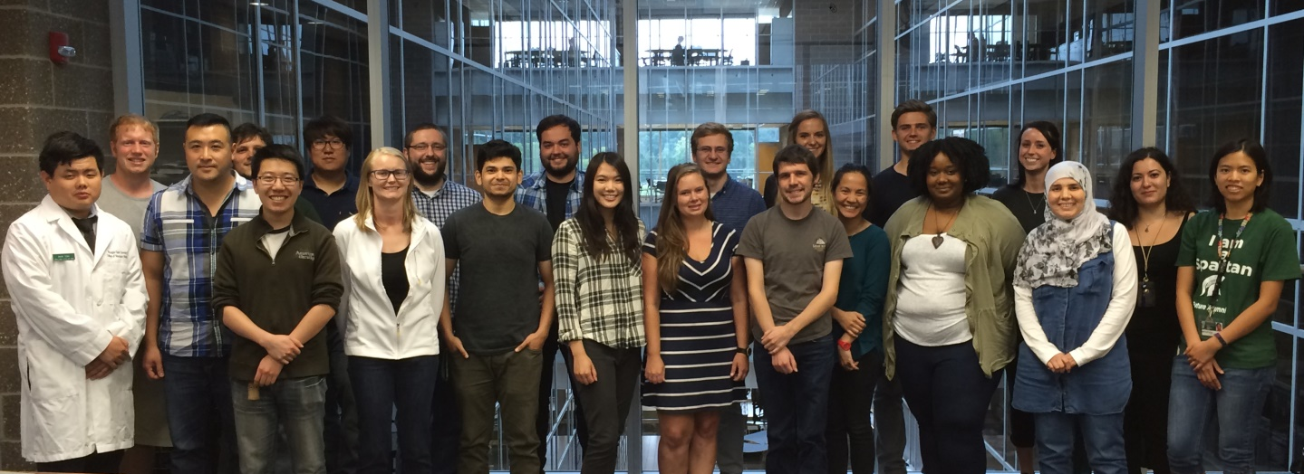
Using Leadership to Grow the
Physiology Graduate Student Council (PSL GSC)
Hillary Woodworth, Physiology MD/PhD Student
March 02, 2017
Notes:
What was the problem and why did you want to address it?
2. What did you do/where is it going?
3. What did you learn along the way about yourself, leadership, life, consciousness, etc.

Slide 2
Physiology Graduate Student Council (PSL GSC)
New GSO (Nov. 2016)
4 E-Board Members Meet Monthly
Major Problem:
<10 Graduate Students to 35 in five years = “growing pains”
Major Goals:
Create sense of community
Plan workshops + social events
Address student issues

Slide 3
Immediate Problem:
GSO momentum slowed after one semester
Immediate Goals:
Administer survey to PSL grad students to gather feedback in order to improve the effectiveness of the PSL Graduate Program and PSL GSC
Plan one workshop or event this semester

Slide 4
Immediate Problem:
GSO momentum slowed after one semester
Immediate Goals:
Administer survey to PSL grad students to gather feedback in order to improve the effectiveness of the PSL Graduate Program and PSL GSC
Plan one workshop or event this semester

Slide 5
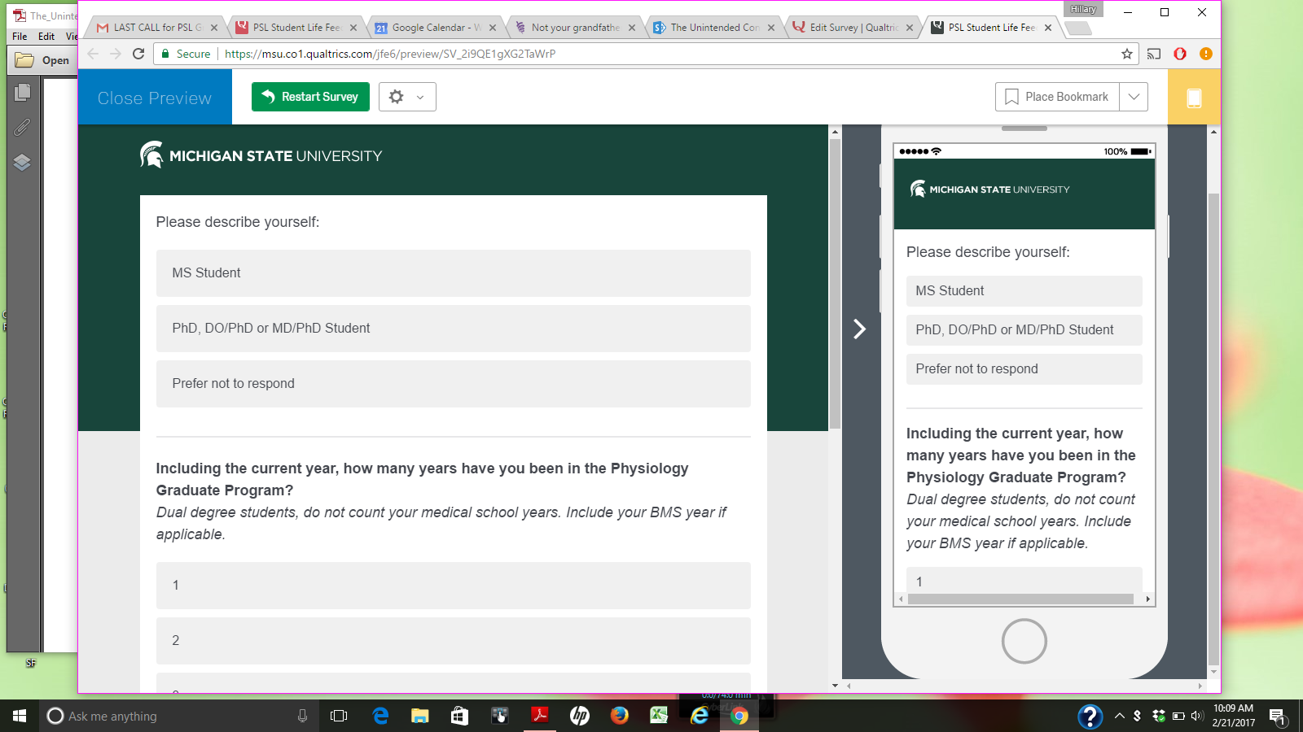
“PSL Graduate Student Life Survey”
Academics
Research environment
Social event preference
Interest in workshops, prof development
20/34 responses =59%
Discuss Results with GSC E-Board and Dept. Chair

Slide 6
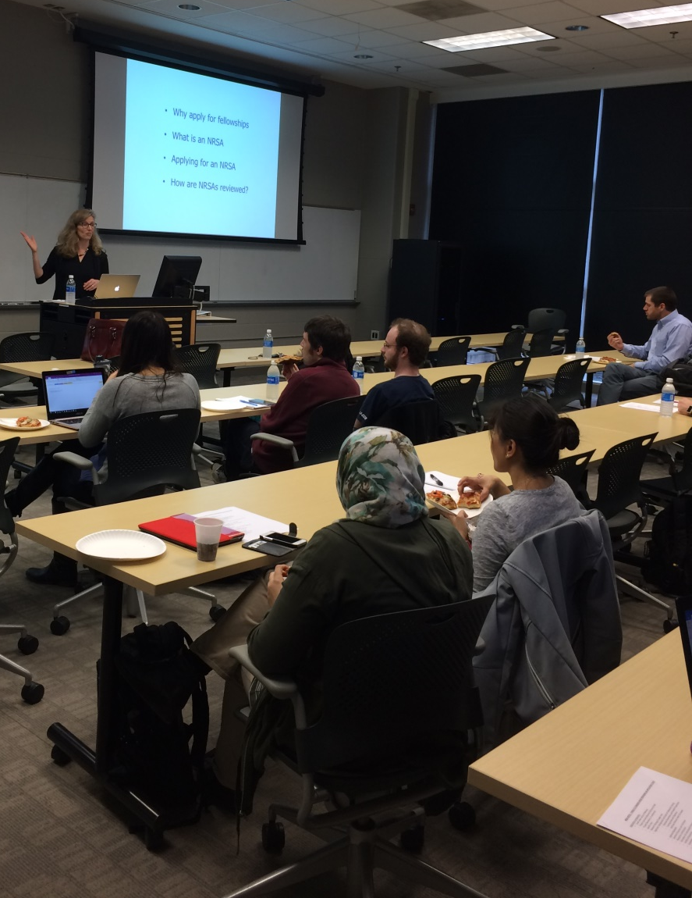
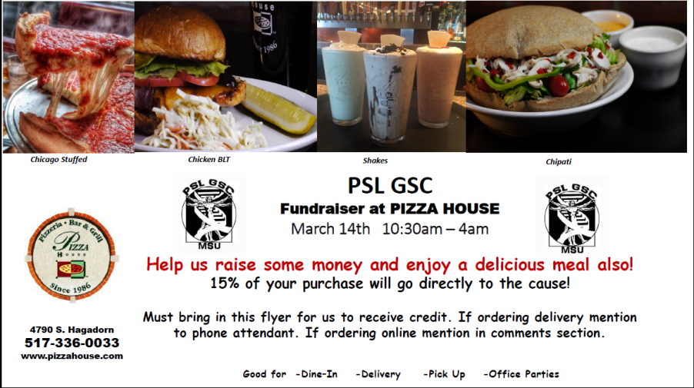
Grant-Writing Workshop
(held on Feb. 21)
Pizza House Fundraiser
(will be March 14)

Slide 7
What I Learned:
Be conscious of your leadership style→ take after a role model
Be accountable and hold others accountable
People from different backgrounds can be extremely helpful
Always practice self-awareness
GO ACCOUNTABILIBUDDIES!

