Slide 1
Graduate Science Communication Tool
Paige Filice
Sanjana Mukherjee
Anne Scott
MSU Leadership Academy- March 2, 2017

Slide 2
The Problem
Graduate students want to communicate their work with the MSU community & public
Lack of interdisciplinary opportunities at MSU to showcase work of graduate students
Potential to fulfill outreach requirements for granting agencies

Slide 3
Why fix it?
We each have an interest in interdisciplinary research and a passion for science communication and our own work.
Desire to give other students the opportunity to share their work and to collaborate

Slide 4
Mission
Promote greater understanding of science through an informal platform to share and explain important research conducted by graduate students at MSU with peers across disciplines
“Science at State” - Interdepartmental Science Website

Slide 5
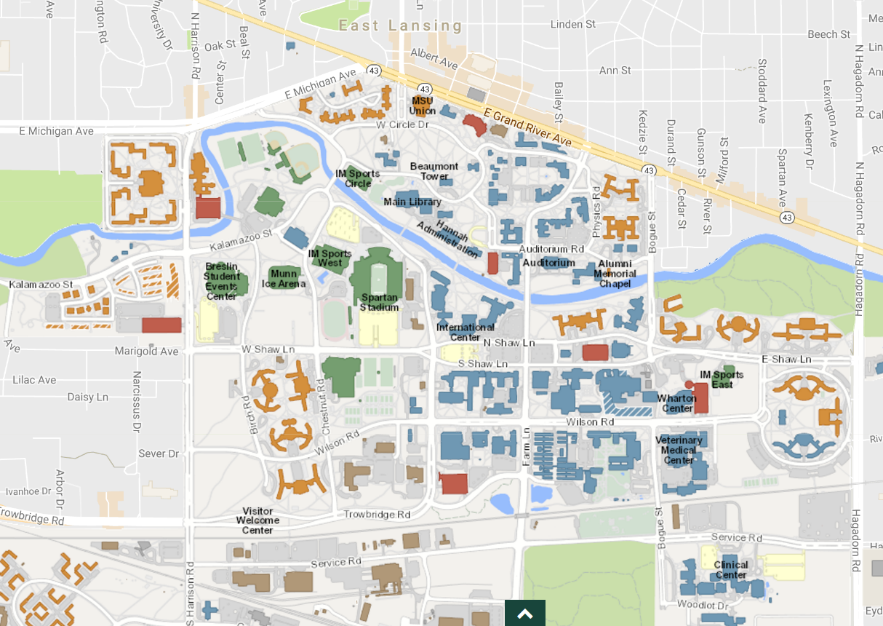

cience at tate
Interdepartmental Science Website

Slide 6

Kaye Blossey
University Licensing
MSU Union
cience at tate
Dr. Matt Helm
Director of Graduate Student Life & Wellness
Burt Bargerstock, Laurie Van Egeren, and Diane Doberneck
University Outreach & Engagement
Steve Sowards
Director of Spartan Ideas
Main Library
Susan Holloway, Jenn Sharp, Tony Frewen
Communications and Brand Strategy
Olds Hall
Sue Nichols
Science communicator
Center for Systems
Integration and Sustainability
Notes:
Strategy thus far
“Science at State” - Interdepartmental Science Website
“Home”- The Graduate School, COGS
Branding and Logistics- MSU Communications and Brand Strategy: look and feel like MSU
University Outreach and Engagement

Slide 7
Next steps
Needs assessment of graduate students
Contributors
Ambassadors
Editorial committee

Slide 8
Learned along the way
Ourself
  Realizing that our values may vary & need to identify common values to have a successful project
Leadership
  Inclusive of all ideas
Life
  Importance of face to face communication vs email
Consciousness
  Need to set aside designated time for the project every week
  Importance of being mindful & mentally present

