Slide 1
The Leadership Academy
Professional Growth Working Group
Lauren Collier-Spruel
Chastity Gaither
Katherine Knowles
Augusto Masiero Gil

Slide 2
Identifying need
Graduate training prepares students for careers in academia
  Tenure track careers are becoming rarer
  Not all students are interested in careers in academia
  Relevant, transferable skills are becoming a necessity for graduates
Peers highlighted areas of need for graduate student growth
Created workshops aimed at developing professional skills
Created online database so students can access content at their convenience
Notes:
Augusto

Slide 3
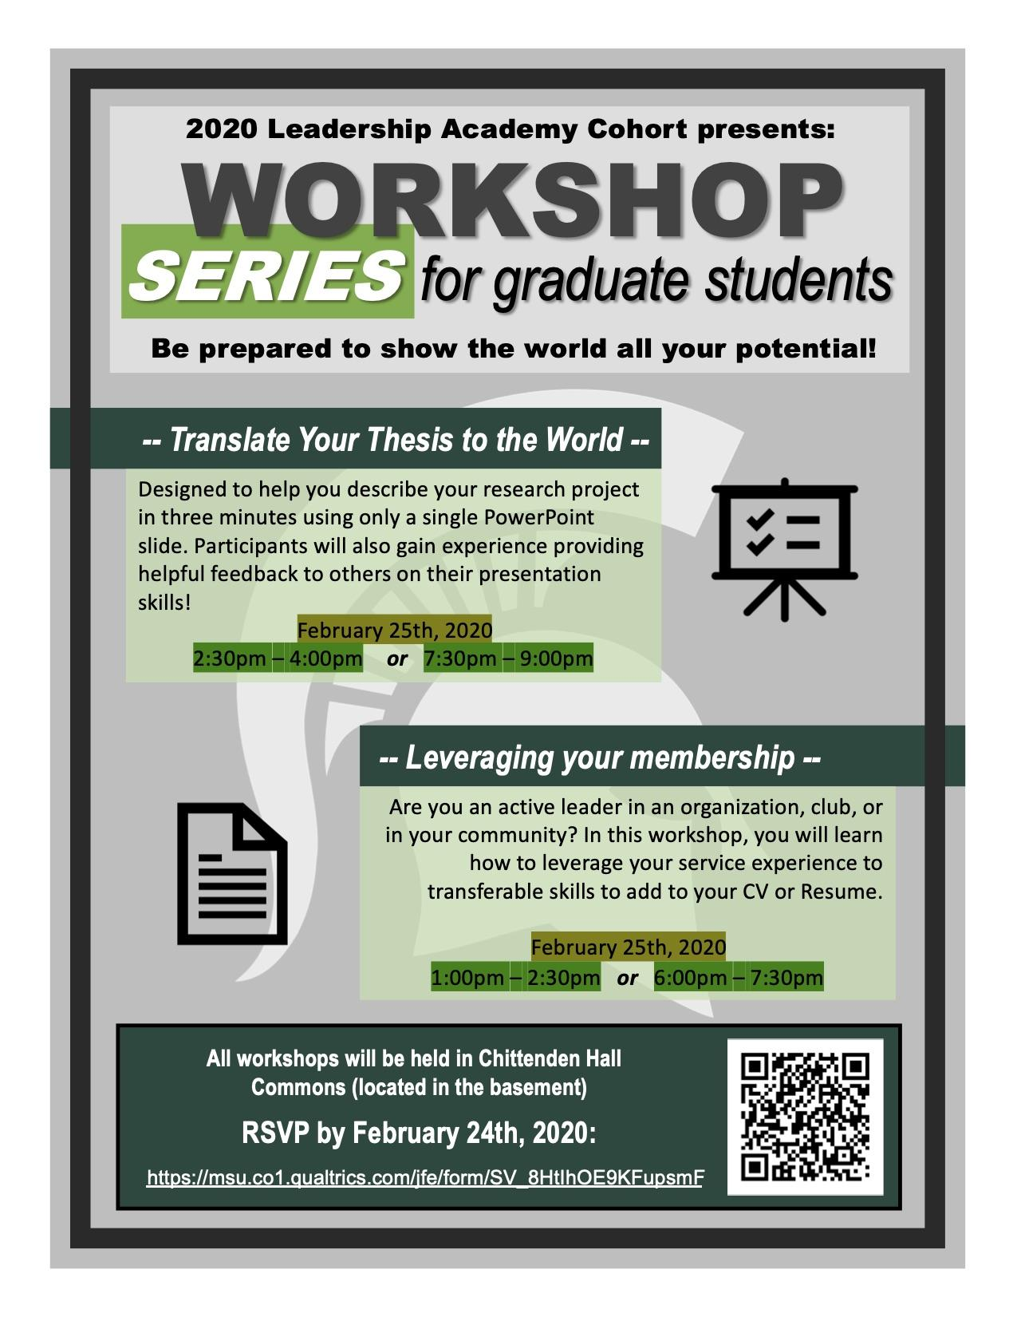
Our plan
Develop two workshops
Publicity/social media campaign
Create an online resource space
Record workshops
Gather participant feedback
Network with campus resources
Notes:
Augusto

Slide 4


Leveraging Your Membership
Learning Outcomes:
Participants learned how to craft a professional development plan
Participants learned how to identify transferable skills
Participants learned how to apply skills/experiences from service organization to their CV/Resume

Slide 5

Translating your thesis to the world
Students learned to transform research abstracts into phrases and images that could be easily understood by others outside their field
  Three sentences
  One sentence
  One slide
Feedback was given by
peers in real time at each
Step
Image: 3 Minute Thesis
Slide created by Ming Lei
Notes:
Lauren

Slide 6
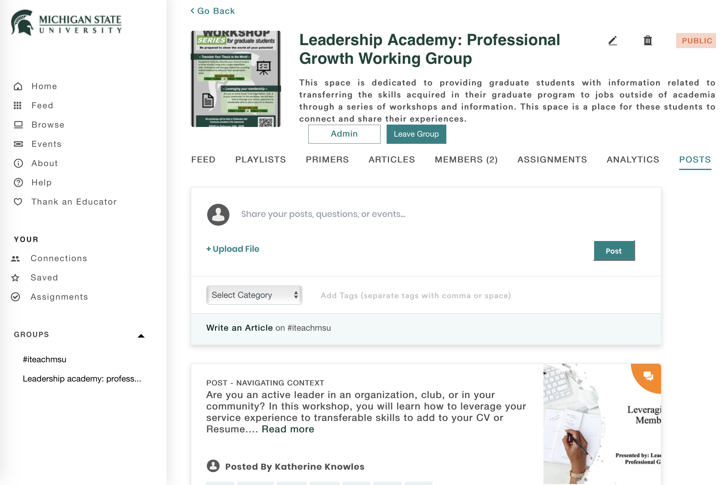
Online Presence
Our iteach.msu.edu group page will serve as a resource for MSU graduate students seeking more information for alt-ac careers. It includes:
  Workshop videos
  Information regarding on campus resources
  Links to existing external resources
  A space for graduate students considering alt-ac careers to connect
The “Leadership Academy: Professional Growth Working Group” on iteach.msu.edu
Notes:
Katie

Slide 7

The day of the workshops
Notes:
Lauren

Slide 8
Feedback
Leveraging your membership:
  4 registrants; 2 attendees
  Overall positive reviews--helped reframe service as transferable skills
  Suggestions: incorporate a CV/resume workshop, more time to network
Translating your thesis to the world:
  5 registrants; 3 attendees
  Overall positive reviews--particularly regarding the practical skills portion
  Suggestions: getting feedback from other grads, better advertising, more time for the session
Notes:
Chastity

Slide 9


Looking forward
Recruitment to online group
Investigating the potential to host additional workshops
Develop a series of interviews/podcasts with MSU graduate student alumni who currently work in alt-ac
Create a more active discussion space for students
Notes:
Katie

Slide 10
Thank you!

