Slide 1

Empowering Students Across Modalities
A Conversation in Three Acts (2022-2023 IAH Kick-off)
10am August 26, 2022
Pırıl Atabay, Ph.D.
Garth Sabo, Ph.D.
Paul Schauert, Ph.D.
Stokes Schwartz, M.A.
Notes:
STOKES

Slide 2
Today’s Agenda
Act I: Introductions and Setting the Scene
(approx. 30 min.)
Act II: Modality and Student Engagement
(approx. 40 min.)
Act III: Looking Ahead
(approx. 20 min.)
Notes:
STOKES

Slide 3
Act I: Introductions, Welcomes, and Setting the Scene
Notes:
PAUL
(Piril and Garth introduce selves)

Slide 4
Act I: Introductions & Setting the Scene
Introductions
Welcome from Cara Cilano, Ph.D., Associate Dean for Undergraduate Studies
Welcome from Ellen Moll, Ph.D., Director of Center for Integrative Studies in the Arts and Humanities (CISAH)
Priorities for IAH
Focus Questions (Reflection & Discussion)
Notes:
PAUL

Slide 5
Individual Reflection (3-5 min.)
Think briefly on the following:
What courses will you teach during 2022-2023?
Describe one IAH course you will teach this year (20 words or less).
What are your personal teaching goals for this year?
Notes:
PAUL

Slide 6
Small Group Discussion (8-10 min.)
**Each group needs a note-taker/spokesperson.**
Quickly share your responses to questions on the previous slide, and then discuss:
How do you currently make your IAH ‘classroom’ an inclusive space?
What are you doing to promote student engagement?
How are you aiming to get your students engaged in the teaching modality you’re using for IAH this year?
Reconvene for sharing/wider discussion. (8-10 min.)
Notes:
PAUL

Slide 7

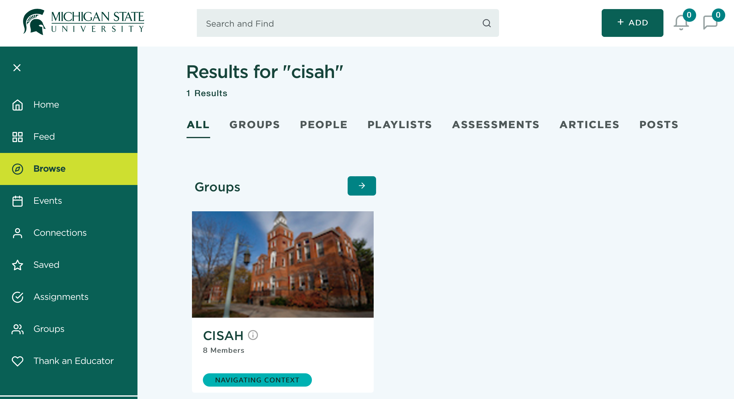
Notes:
PAUL
https://iteach.msu.edu/groups/cisah/feeds

Slide 8
Act II: Modality and Student Engagement
Notes:
PIRIL

Slide 9
Act II: Modality & Student Engagement
Student Engagement/Empowerment
“OnLive” Teaching and the Best of Both Worlds: How F2F and Online Teaching Can Inform Each Other
Notes:
PIRIL

Slide 10

Notes:
PIRIL
https://president.msu.edu/_assets/documents/DEIreportandplan_081021.pdf

Slide 11
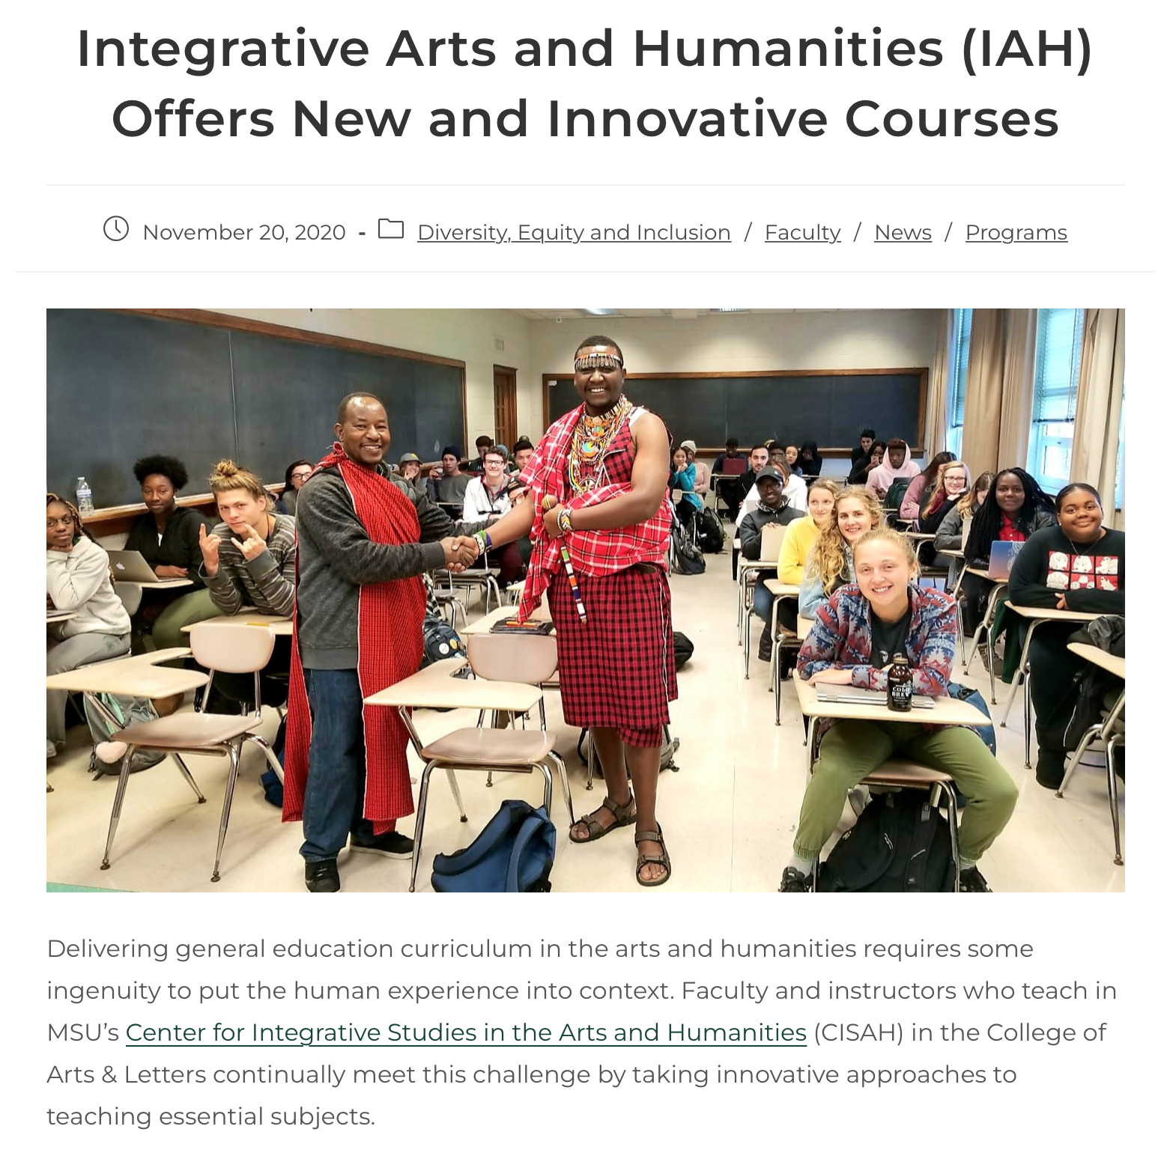
Notes:
https://cisah.msu.edu/2020/11/20/integrative-arts-and-humanities-iah-offers-new-and-innovative-courses/
PIRIL

Slide 12
DEI in IAH Summer Fellows
2022 IAH DEI Summer Fellows
  Facilitators: Ellen Moll and Denise Troutman
  Participants: 11 faculty; 4 Teams
      Approaching Diversity
      Disability Justice and Trauma Informed Teaching
      Creating an Inclusive Pedagogy
      Community Engagement, Service and Experiential Learning
Notes:
PIRIL/STOKES

Slide 13
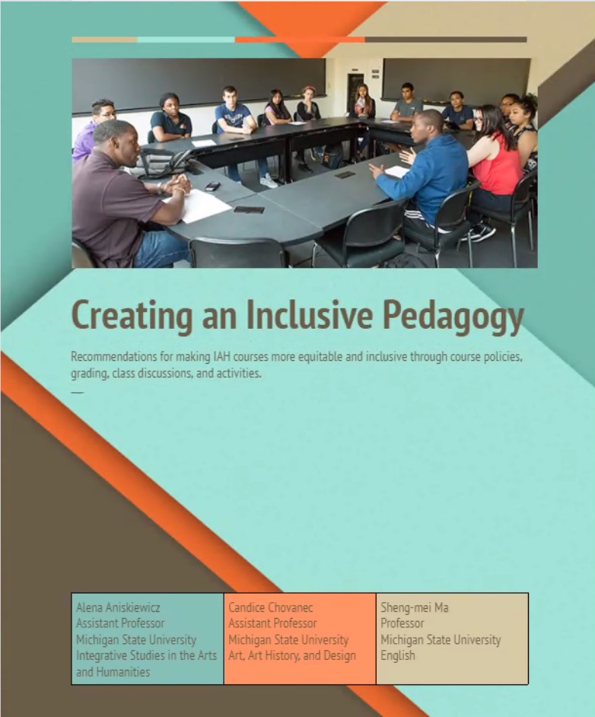
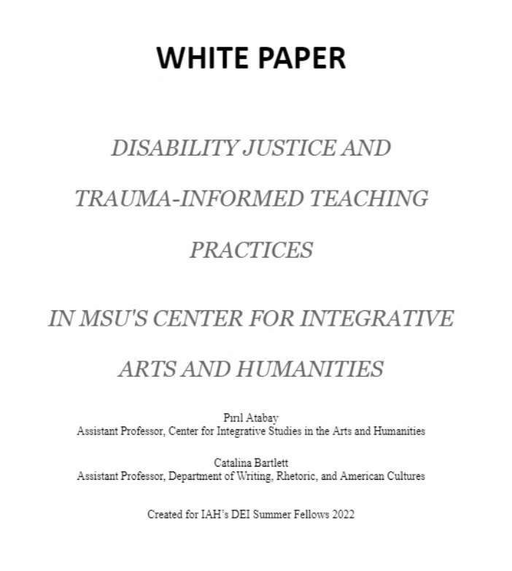
DEI in IAH
DEI in classrooms:
  Universal Design
Notes:
PIRIL/
Screenshot white paper(s)

Slide 14


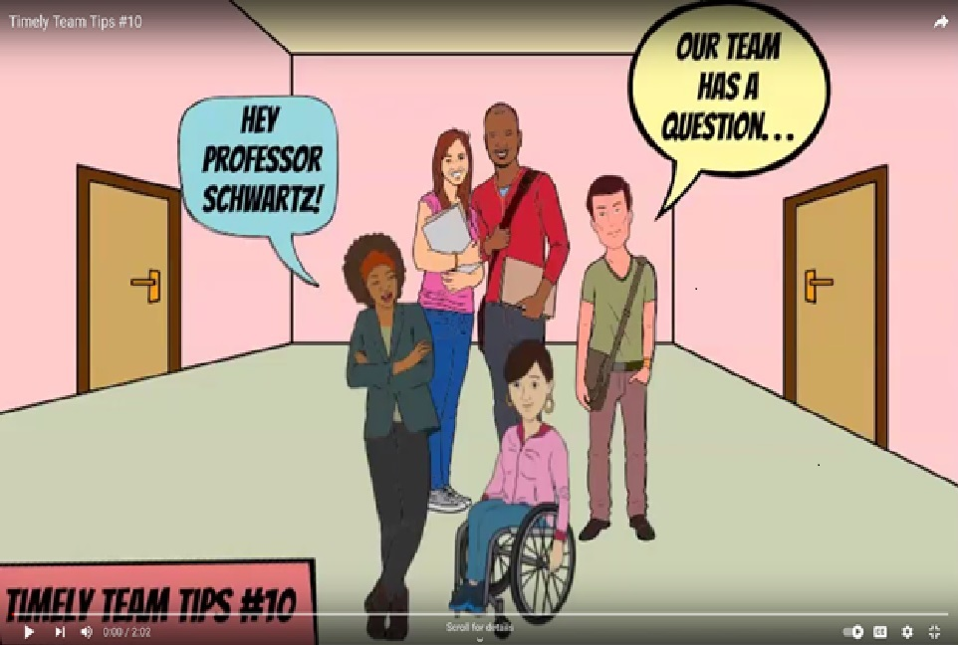
Notes:
EXAMPLES PIRIL/STOKES (inclusivity)

Slide 15
Small Group Discussion (8-10 min.)
**Each group needs a note-taker/spokesperson.**
How has teaching in multiple modalities changed your approach to student engagement overall?
What are you doing now, or what will you do, that you weren’t doing pre-Covid?
Examples?
Reconvene for wider sharing/discussion.
(8-10 min.)
Notes:
GARTH

Slide 16
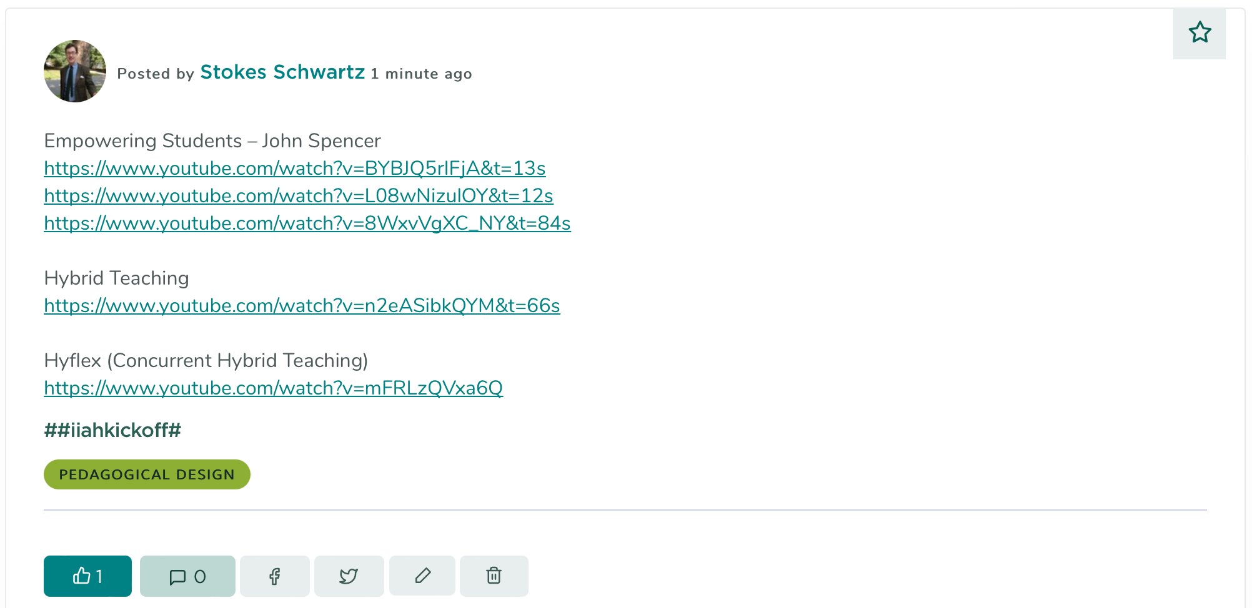
Notes:
GARTH

Slide 17
Act III: Looking Ahead
Notes:
GARTH

Slide 18
Act III: Looking Ahead
Workshop Schedule for Fall 2022
Suggestions and availability for workshops
Notes:
GARTH

Slide 19
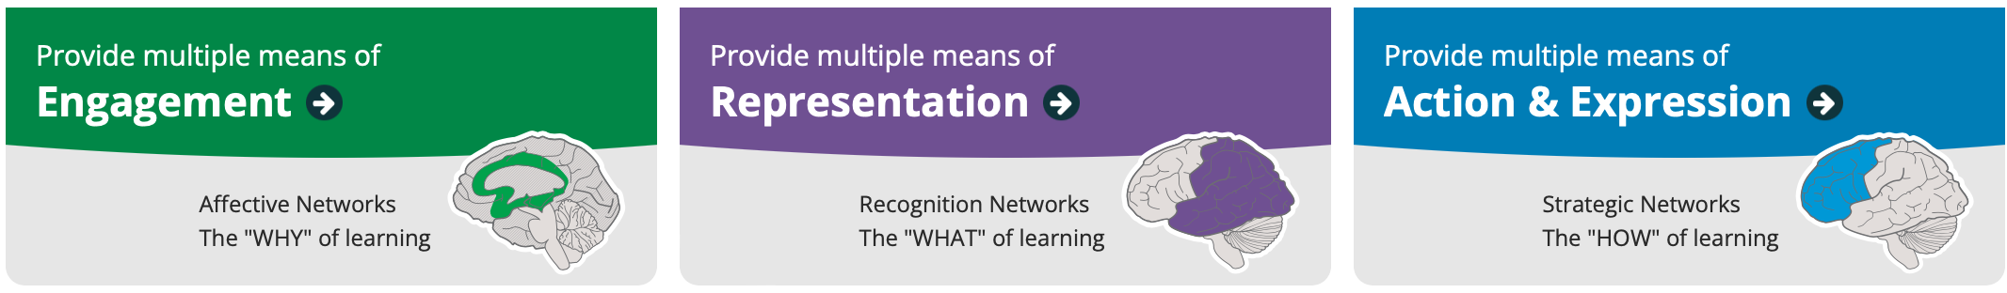

Universal Design for Learning: UDL in IAH (mid-October)
Notes:
GARTH

Slide 20
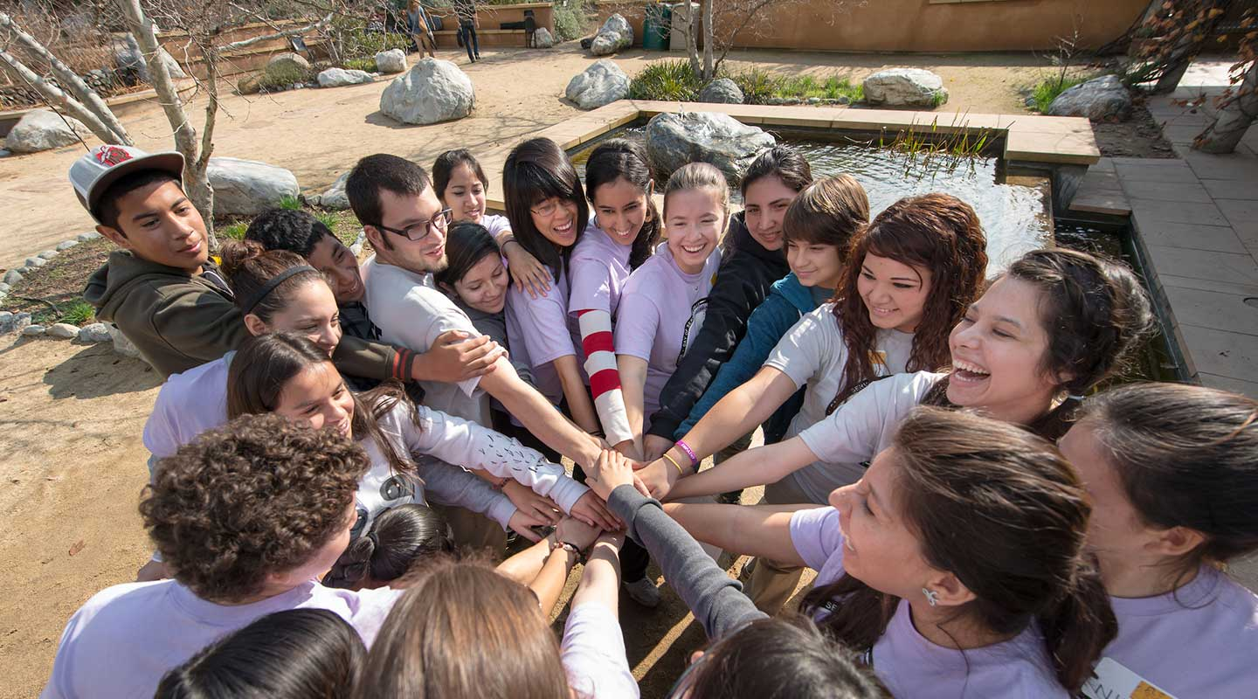
IAH, Community Engagement, and Service Learning (early November)
Notes:
PAUL/STOKES
Update with Paul changes

Slide 21
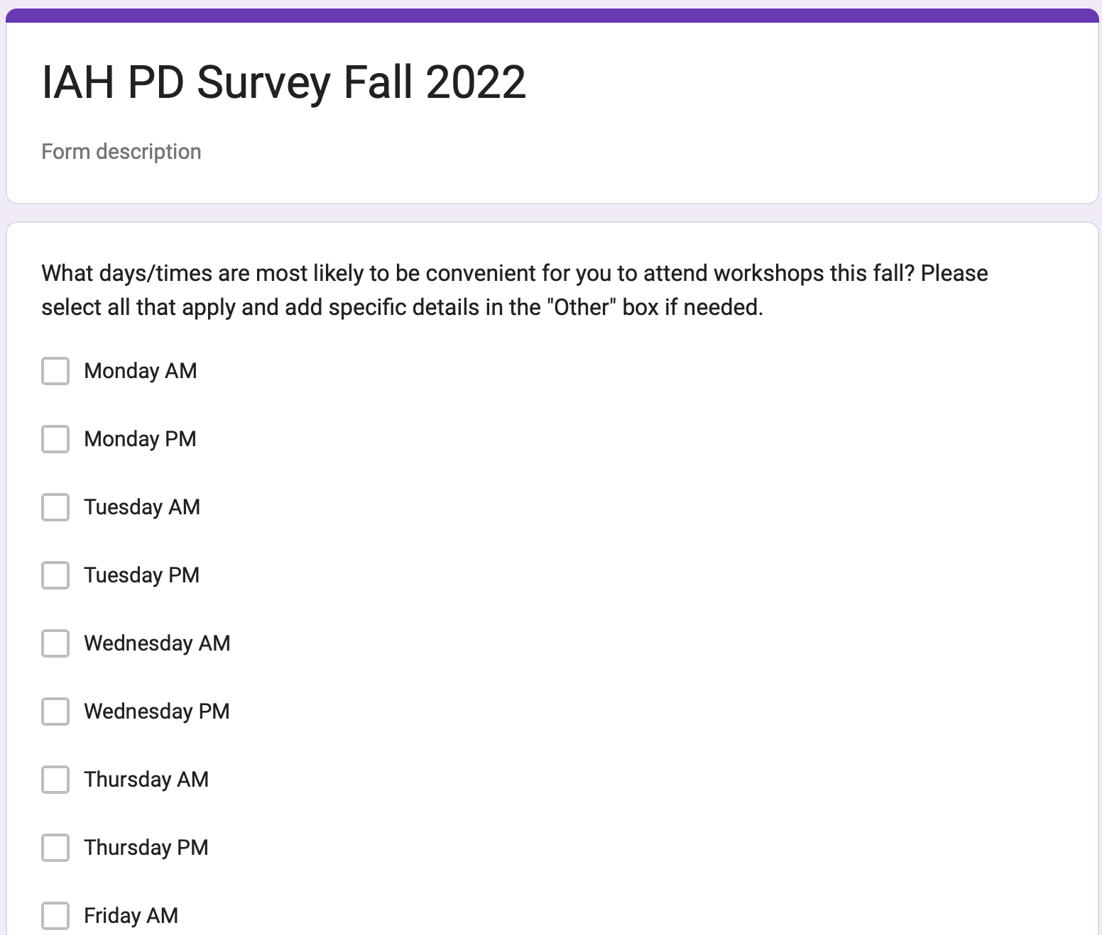
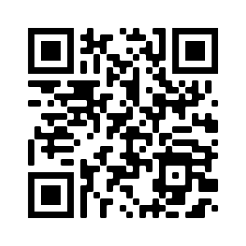
Notes:
PAUL/STOKES
https://forms.gle/yoWbTRrrUN87AHuf7

Slide 22
Open IAH Q&A
Notes:
PAUL/STOKES

Slide 23
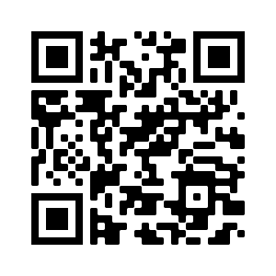
Thank You!
Workshop feedback
Notes:
PAUL/STOKES
https://forms.gle/k2xH4nkWe7CSqeCZ7

