Slide 1

Library Discovery Systems Update
Emilia Marcyk-Taylor
Head, Reference and Discovery Services
MSU Libraries

Slide 2
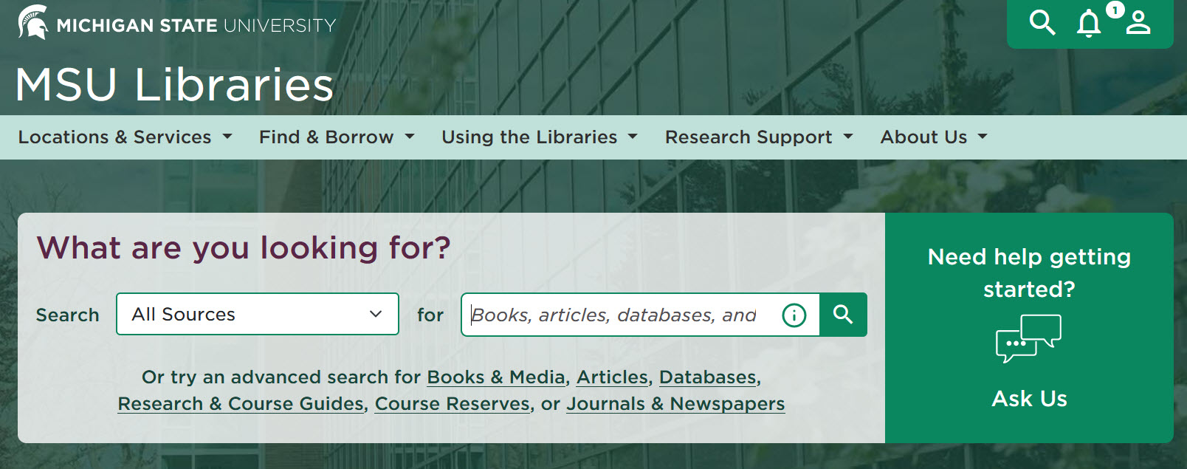
Homepage Search (Bento Box)
Dropdown options:
All Sources
Books & Media
Articles
Databases
Research & Course Guides
Course Reserves
Our Website
Notes:
Electrical engineering

Slide 3
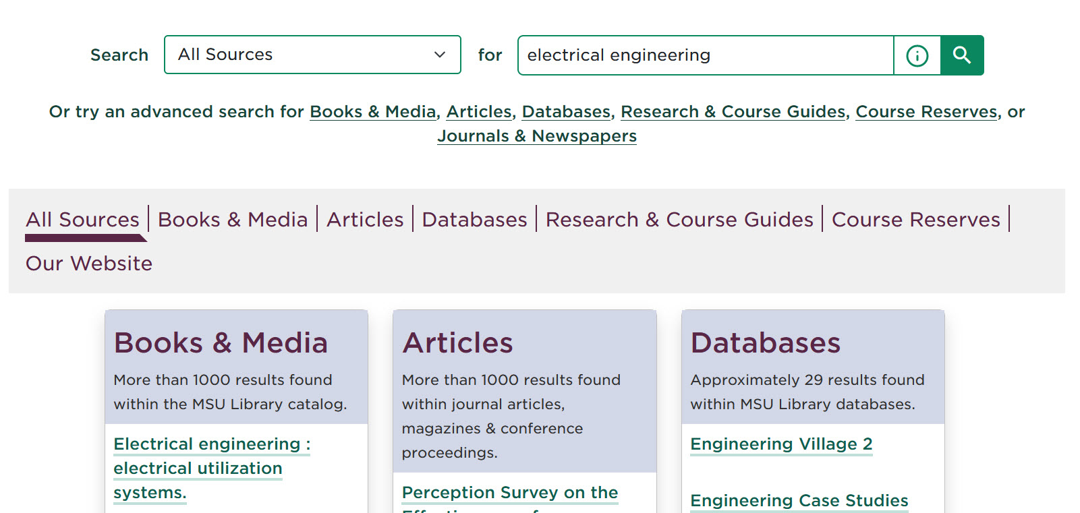
After searching:
"All Sources" displays 6 boxes
OR user can navigate to a specific type of information

Slide 4

Reminder: you can search by title or
DOI

Slide 5

Advanced search options are available
(most librarians go to these directly)
Notes:
We can talk about any of these in more detail if there are questions

Slide 6
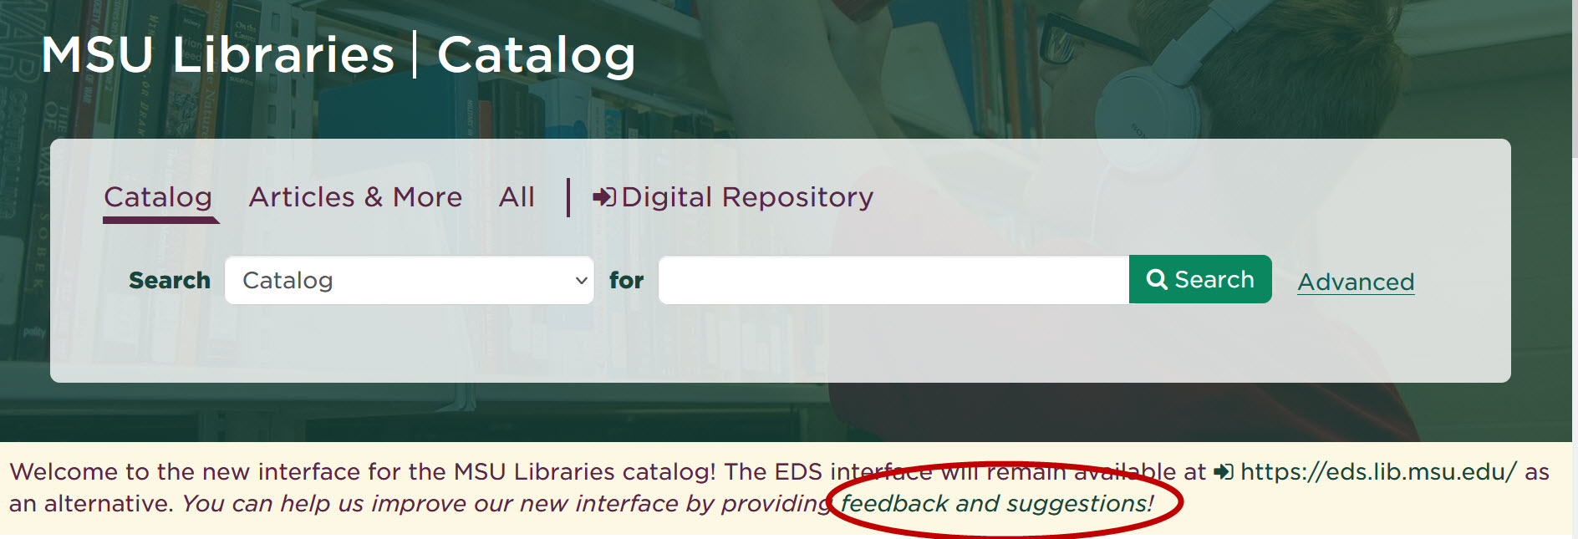
Catalog catalog.lib.msu.edu
Catalog = Books and Media
Articles
Feedback appreciated – use the Feedback and Suggestions form
Notes:
Let me know if you want me to demo any searches in the catalog

Slide 7
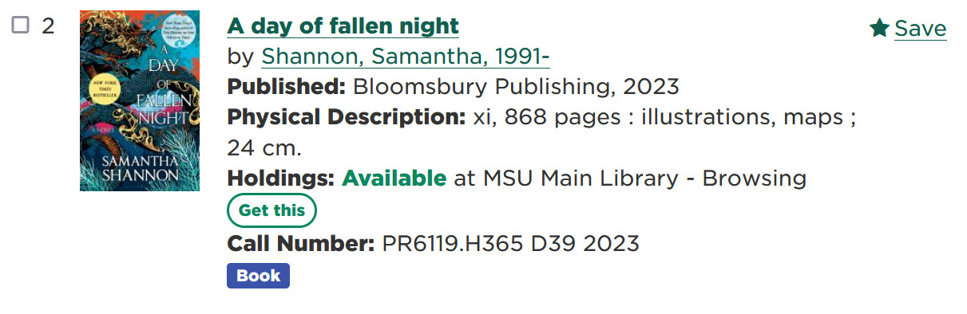
Book Search Results Page
Availability Status
Call Number
“Get This” button
  Office Delivery
  Distance Delivery
  Article/Chapter Scan
Click on the title to see the full item record
Notes:
Day of fallen night

Slide 8
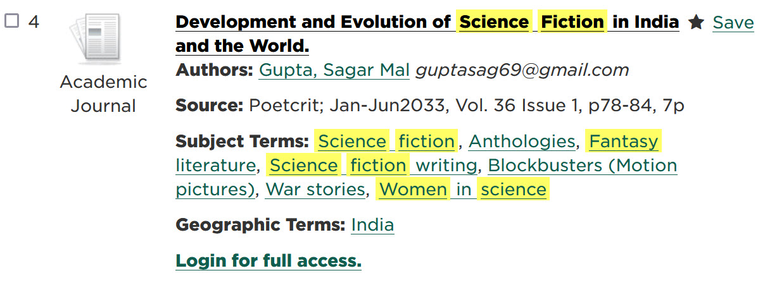
Article Search Results Page
Source
Subject terms
Access link
Click on the title to see the full item record & other access options
Notes:
Women in science fiction

Slide 9
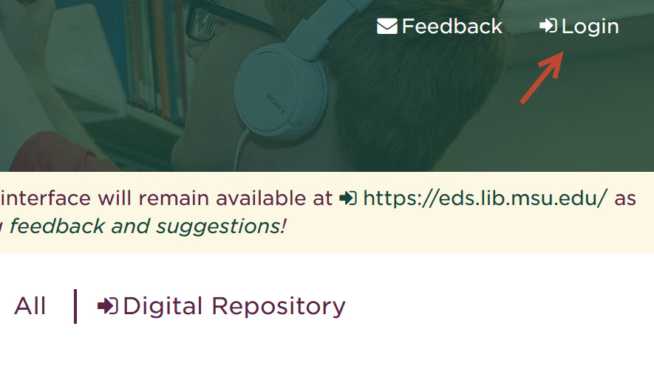
User Account
Renew books (multiple at the same time!!)
Save searches and results
Create lists (books or articles)
Make sure you select “Institutional Login”

Slide 10
Ask Us lib.msu.edu/askus
Research and reference
Technical support and online resource troubleshooting
No matter how you contact us, we will direct you to the right person!
Notes:
Questions:
How do we get the word out about how to get help?
Related to the interface: splitting books and articles is a product of our old system. Based on your own search behaviors, does it make sense to combine or keep them separate?
What other questions or demos do you have for me?

