Slide 1
Why every teacher should go on a Community Walk:
A reflection on community engagement for world language teachers
Hannah Fulmer and Noah Bachmann
Undergraduate students in the MSU Teacher Preparation Program
Notes:
Ask if there are any WL teachers present
If there aren’t any/many, explain that it’s still beneficial for teachers (and their students) of all disciplines, as taking students on a Community Walk and helping them to become aware of the presence of different cultural groups in their town/city and learning about their history, culture, languages, religious beliefs, etc. is essential in order to help our students become more accepting, aware, and social justice-oriented people. They’re our future!

Slide 2
Speaker Introductions
Hannah
Spanish Major
4th year student at MSU
Future World Language Teacher
Going to teach in Spain next year
Noah
Spanish Major, TESOL (Teaching English to Speakers of Other Languages) Minor
4th year student at MSU
Future World Language/ESL Teacher
Current teaching experiences:
Instructors for the Okemos World Language Program, 2023-2024
Assistant teachers in local high school Spanish classroom
Noah: Assistant teacher in a high school ESL classroom
Notes:
Noah and Hannah

Slide 3
Are you a…
Teacher who wants to help their students gain more cultural awareness regarding their immediate community?
World language (WL) teacher and want to help your students see the relevance and value in learning the target language (TL) of your classroom?
Teacher who wants to make their course content more culturally relevant and sustaining?
Notes:
Noah
…Then a Community Walk may be a great activity to incorporate into your classroom curriculum!

Slide 4
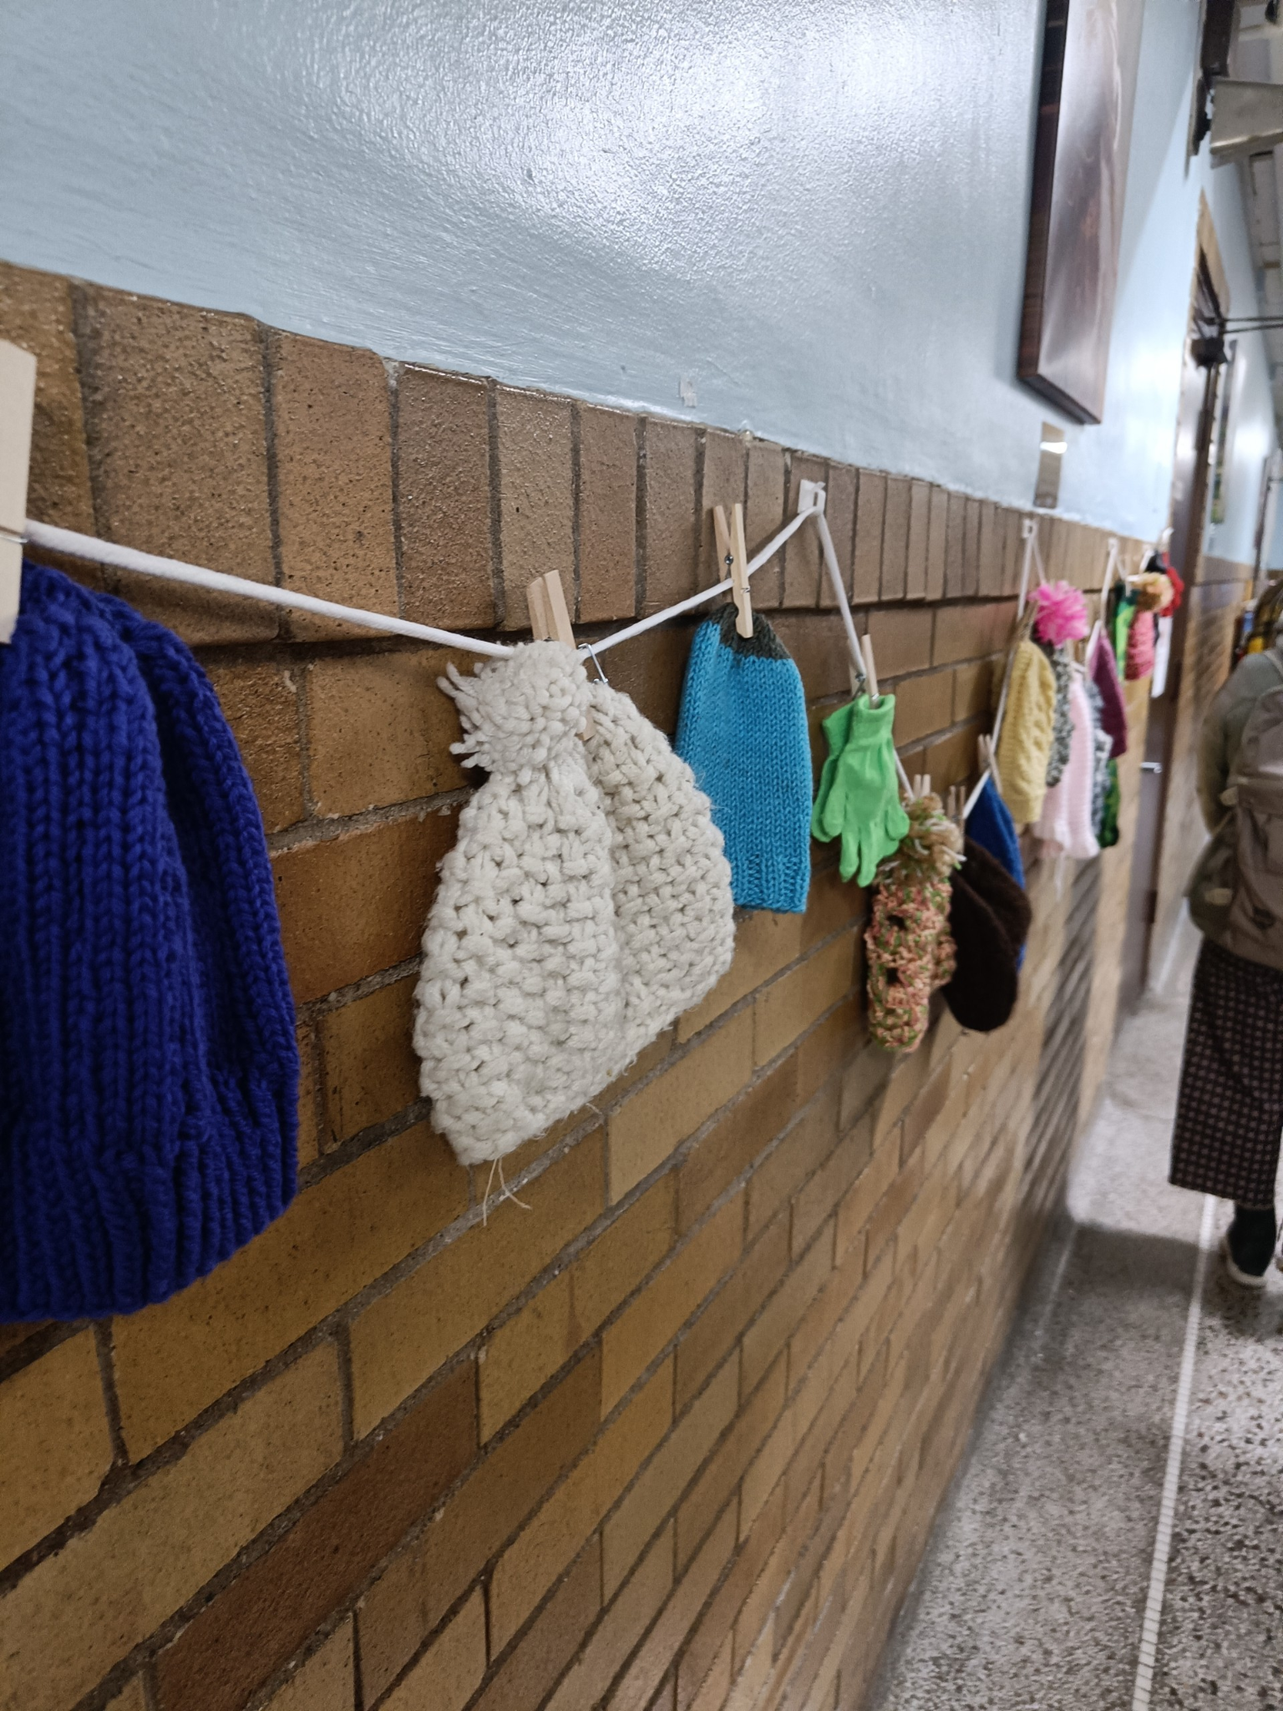
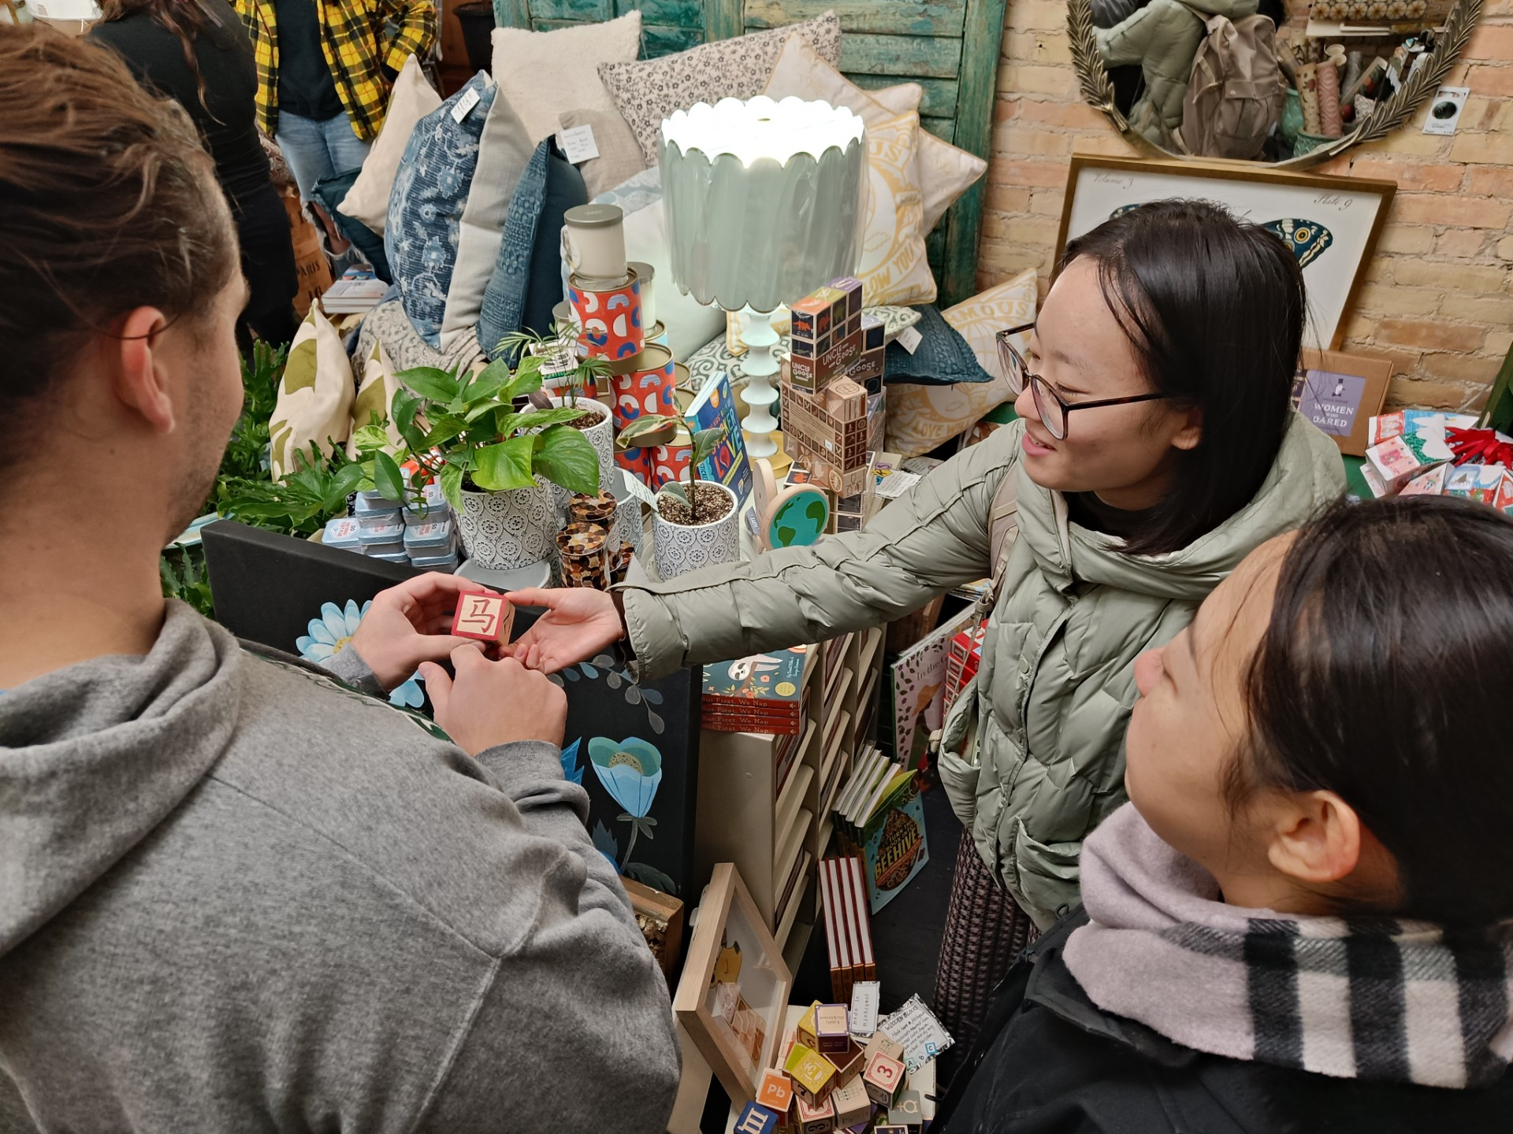
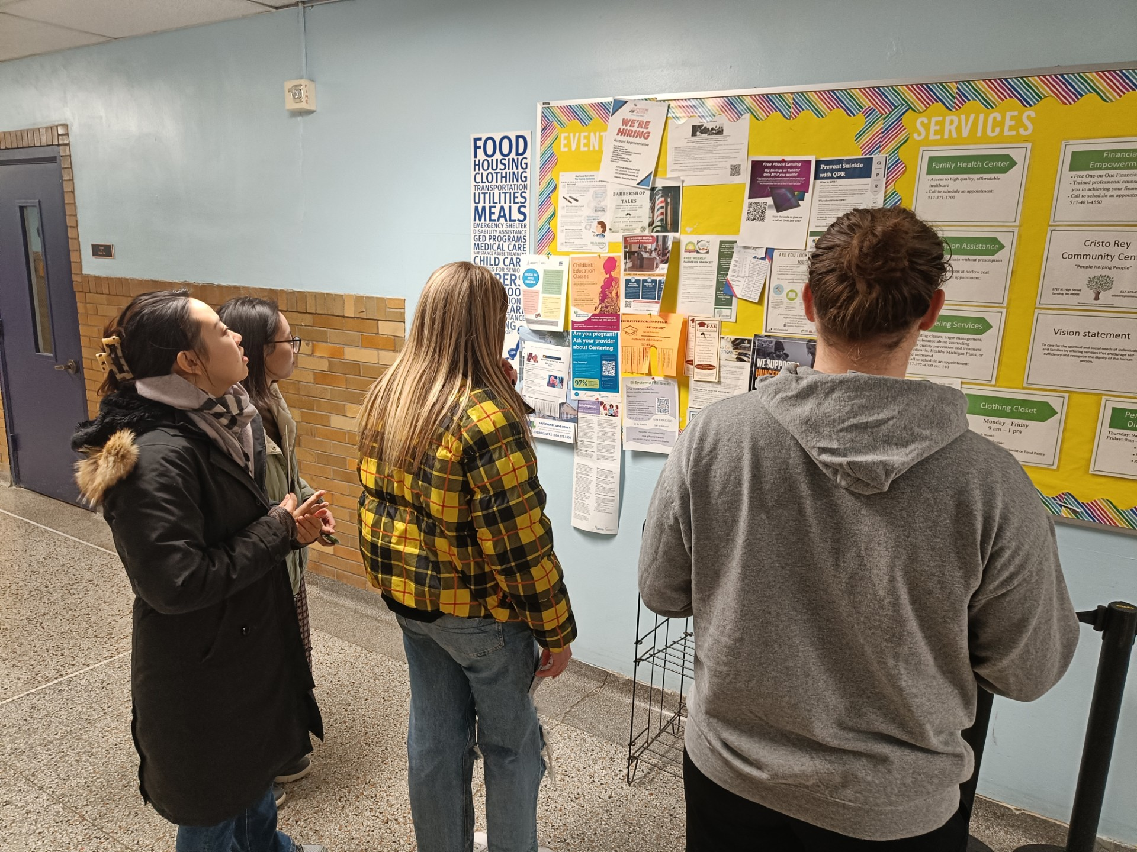
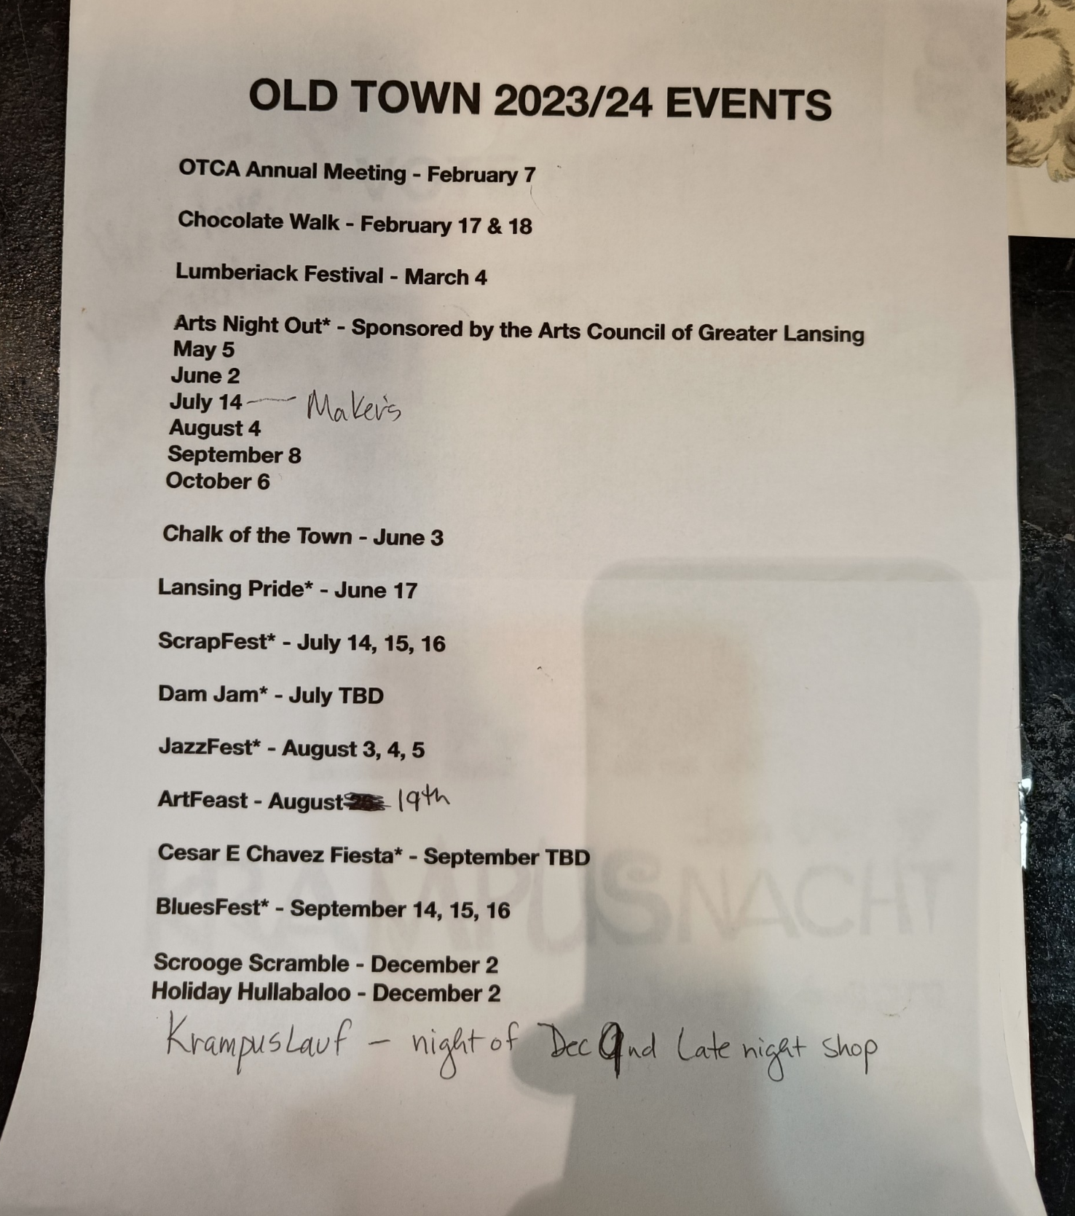
What is a Community Walk?
A walk through your city and community
Visit different areas of your community
Interact with locals
Notes:
Noah
Helps show what languages are present in a community (if there is a large Spanish population maybe there will be more signs in English and Spanish). Helps determine if there is a certain racial/ethnic group that is underrepresented/oppressed in that area. You can learn about the history of the community (ex: In GH there is such a lack of diversity because for part of the 20th century it was illegal for people of color to own or buy land in GH, which explains why there is a lot more diversity in neighboring cities Muskegon and Holland.) Essential to learn about the population, the common industry(s), culture, everything about the city. Students that grow up in that city might not even know that much about it, maybe they’re from one side of town and don’t go to other parts of the city that are much different from their part.
What it is
A walk around the community (by teachers and/or students) to see the different languages, cultures, and people in your area.
Go and view different stores, restaurants, landmarks, paintings, holidays/festivals.
Interacting with locals (advice, knowledge, history, etc.)
Purpose/why do it
Beneficial for teachers and students
Help determine what languages are represented in the community
Learn about the history of the community and what shaped it into what it is today.
Learn about the different cultural aspects/make up of a community (oppressed/underrepresented)
Learn about important industries to the town (if it is a big automotive town it is likely that the kids will know more about cars/have parents that work in the factory/are mechanics)
Our abstract:
Understanding how the target language of a classroom is used within students’ communities, as well as its historical and cultural context and significance, is essential in order to be an effective foreign language instructor. An efficient way to gain this greater cultural and historical awareness is through participating in a community walk. This exercise involves researching how and with what frequency the target language has been used in students’ immediate community, as well as experiencing the language firsthand by visiting institutions within the community that utilize the target language to some extent, whether by making use of the target language regarding elements like signage and website information or by being owned and operated by native speakers of the language. Community walks offer a wide variety of benefits and are essential for teachers that are beginning to work in a new area. A community walk offers a look into the history, culture, and language that has built a community and allows for a teacher to better understand their students.
A physical walk/tour of a neighborhood within the city that you teach in, in which more speakers of the TL reside and work and there is a greater presence of the TL compared to other parts of the city

Slide 5
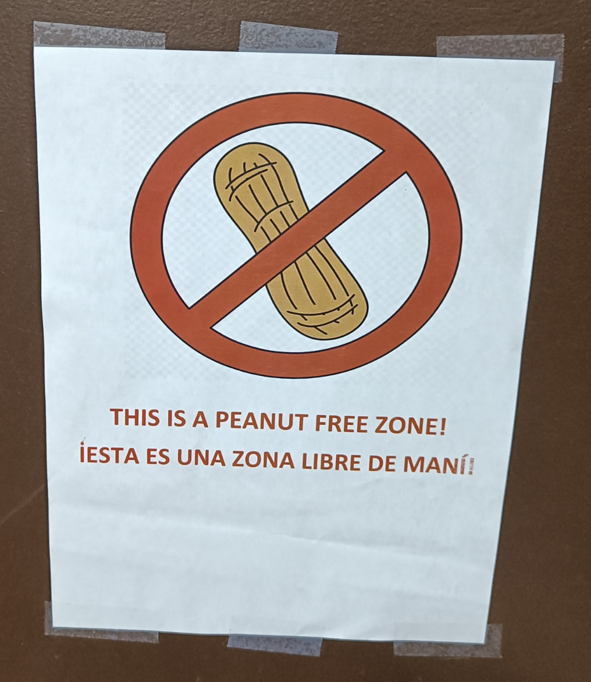
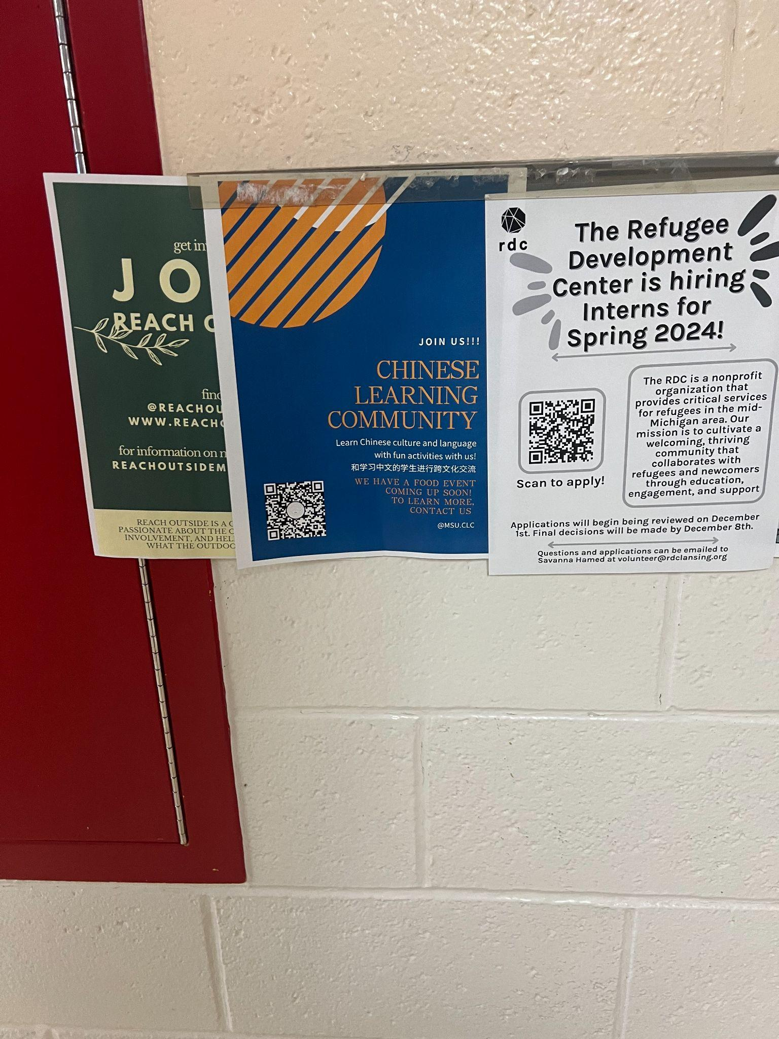
Why organize a Community Walk?
To increase cultural awareness
Allows you to get to know the community around you that speaks the target language
  History of the community
  Cultural values & differences
  Students who may be a part of that community
To acquire authentic resources for your classroom
To establish relevance
Relevance + interest increase → motivation increases
  Guilloteaux & Dörnyei, 2008
  Dörnyei, 1994
Notes:
Hannah

Slide 6
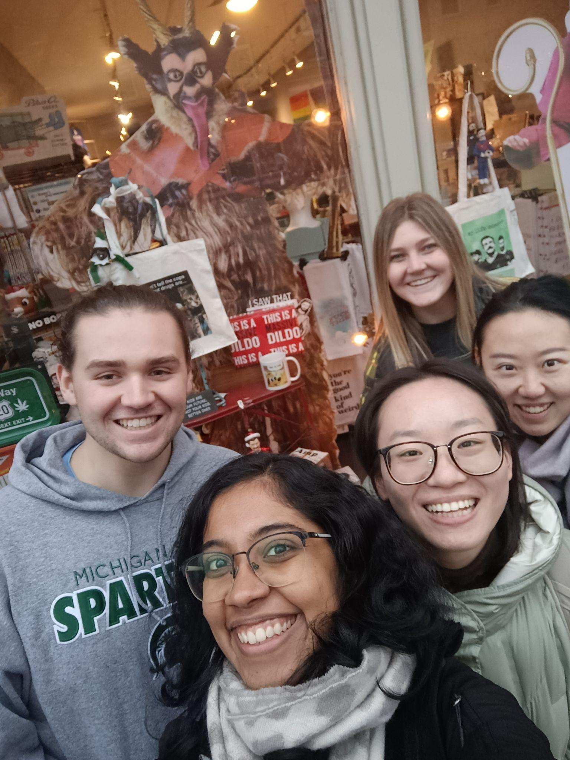

Recommendations on planning a Community Walk
Don’t go alone!
2.) Choose your destinations thoughtfully and intentionally
What are your goals?
What do you want students to take away from this experience?
3.) Collect artifacts
Flyers, pamphlets
Books
Posters
Take photos
4.) Discuss & Reflect
Notes:
Hannah
Don’t go alone: plan it to be a field trip so that your students can it experience firsthand with you
(if you can’t bring your students, be sure to bring back artifacts/authentic resources or photos to share with your students so that they can still learn/gain more cultural awareness from your experience)
Choose your destinations thoughtfully and intentionally: think about what you really want students to learn about the community near them that speaks the TL
Do you want them to learn about the history of this community (i.e. Why that community immigrated to this area and why there may not be as large of a community now, in the present day, etc.)
We learned about the history/immigration of Latinx people to the Lansing area through reading historical signs/markers in the Old Town neighborhood, in addition to doing research prior to our community walk
Many Hispanic people/Latinxs moved to this area to work for the Michigan Sugar Co. beet factory and a nearby GM plant in the early/mid 1900s
We also learned how the Cristo Rey Community Church, a bilingual church that was extremely important to the Latinx community here, was demolished in 1965 in order to facilitate the construction of part of I-496; today, the lot that housed the church is a parking lot for GM’s Lansing Grand River plant; might’ve been the beginning of the loss of Hispanic culture and the decline in Hispanic population in this area (quickly became less of a cultural hub after this event)
Do you want them to learn about things like traditional foods, celebrations, and religions/customs that people in this community have?
We were able to explore traditional Mexican, Peruvian, and Cuban cuisine through our community walk
Stopped in to local, family-run Mexican supermarkets
Ate at a traditional, Latinx-owned Mexican restaurant
Leaned about traditional Peruvian and Cuban foods, dishes, and ingredients by looking at their menus beforehand/stopping into the restaurants
Do you want them to see how the language is used in specific parts of that city, like in hospitals/clinics, grocery stores/shops, community centers, etc.?
Through stopping in to the Cristo Rey Community Center, we got to see how the language is used in a plethora of ways in the Old Town neighborhood of Lansing and how it’s still very important/relevant to its residents
The name of the building itself
Many of the employees (like the secretaries and nurses/nursing assistants) are bilingual in both Spanish and English in order to better serve the community
The signs in the community center were all, for the most part, written in Spanish and English
There were also many flyers that were hung up on bulletin boards that were in both Spanish and English (or just Spanish), and flyers that advertised for different language communities (point to “Chinese language community” flyer, as well as English-learning groups for speakers of other languages)
Depending on how deep you want to go and what specific areas of society you want to touch on, what you want to share may vary!
Collecting artifacts is important so that you can put them in your classroom and share them with students so that they have a constant reminder of the importance and relevance of the TL in their own community/town, serving to remind them that the TL can be used in their own backyard, not only in a different country thousands of miles away
→ increases student motivation; they’ll realize that learning the TL is valuable and useful
Discuss & reflect: Have your students share what they learned in small groups or with the class
What did they learn?
What did they already know?
Did anything surprise them?
How has this affected/changed their perspective/understanding of the community that speaks the TL around them?
How has this impacted their understanding of the TL itself? Do they view speaking the TL as a more valuable skill now, after learning about its prevalence in their own community?

Slide 7

Asset vs deficit-based approaches
Asset-based
Identify existing strengths and resources
View members as assets with skills
Build on strengths in a community
Deficit-based
Identify problems and needs
View members based on challenges
Can reinforce stereotypes and stigmatize the community
Notes:
Noah

Slide 8
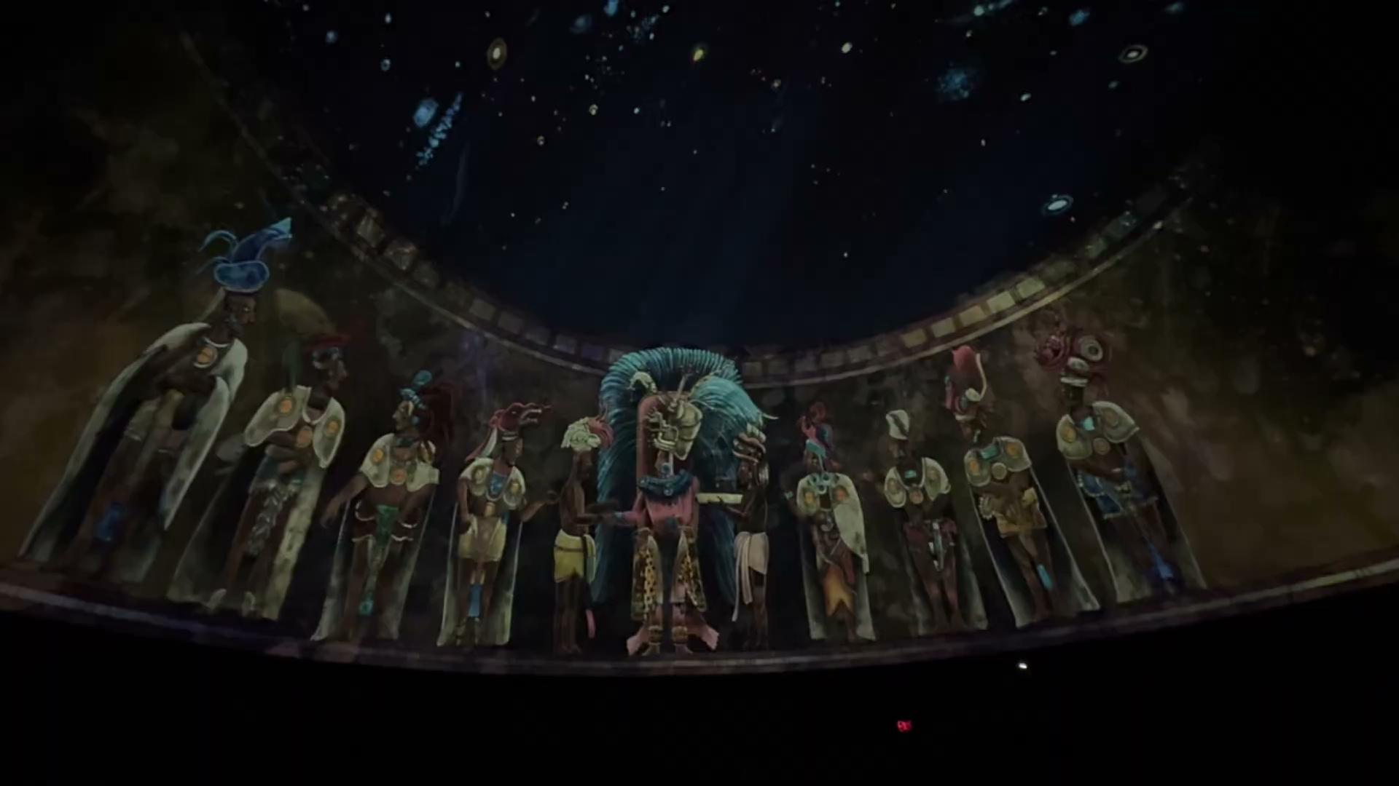
Pedagogical Implications
Artifacts
Videos
Photo collages
Physical items
Reflections:
Journal entries
Videos
Drawings
Suggestions for reflection questions:
What did they learn?
What did they already know?
What surprised them?
How has this affected or changed their perspective/understanding of the community that speaks the TL around them?
How has this impacted their understanding and view of the TL itself?
Notes:
Hannah
How we can create assignments from this and utilize it in the classroom:
Students can be tasked with bringing back an artifact from the walk and writing a short paragraph or making a short video talking about it, using the TL
They could also be tasked with creating videos or photo collages that represent their actual experiences from the Community Walk. You can hang up the collages in your classroom to serve as a constant reminder of the unique cultural identities of your students’ immediate community and the presence/prevalence/relevance of the TL in that community.
They can also be tasked with something as “simple” as answering journal reflection questions, which can be answered using the TL or any other language that the students prefer or identify with, as this is more of a cultural exploration and culture-sustaining activity. Alternatively, students could also create videos using the TL or drawings in which they answer these questions in order to make this a multi-modal reflection assignment. In the video they could use the TL as much as possible to give their answers. In the drawings use labels.
“How has this impacted their understanding and view of the TL itself?” – do they see more value in learning the TL now? Are they more motivated to learn it? Do they see more of a purpose in learning it after going on the Community Walk and seeing the TL’s use in day-to-day life in their own town/city?

Slide 9

Conclusions
Increase cultural awareness
Acquire authentic resources for your classroom
Learn about the history, language, and culture of your community
Learn more about your students
Notes:
Noah/Noah and Hannah
Community walks increase cultural awareness.

Slide 10
Questions or comments?

Slide 11
References
Dörnyei, Z. (1994). Motivation and motivating in the foreign language classroom. The Modern Language Journal, 78(3), 273. https://doi.org/10.2307/330107
Guilloteaux, M. J., & Dörnyei, Z. (2008). Motivating Language Learners: A classroom‐oriented investigation of the effects of motivational strategies on student motivation. TESOL Quarterly, 42(1), 55–77. https://doi.org/10.1002/j.1545-7249.2008.tb00207.x

